Slide 1

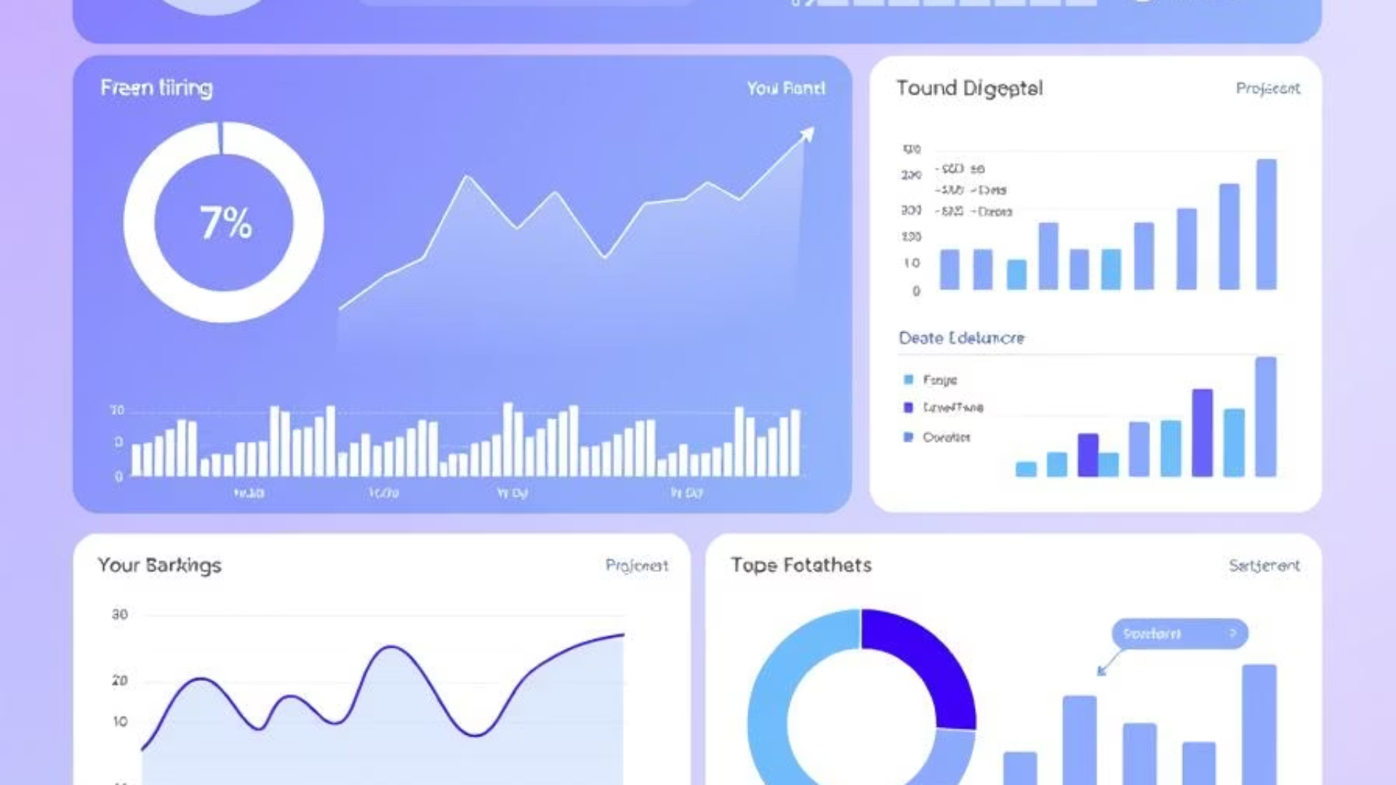

Exploratory Data Analysis (EDA) in banking
Discover how EDA transforms raw banking data into actionable insights for better loan decisions.
By;
Sohini
Vaibhavi B Raj
Notes:
1

Slide 2

Introduction to EDA
What is EDA?
Early Problem Detection
Exploratory Data Analysis helps understand dataset structure, patterns, and relationships before modeling.
EDA identifies issues in data that could affect analysis quality.
Maximise the insight in the data set
Detect outliers and anomalies
Test underlying assumptions
Better Decision-Making
It provides insights that improve business and modeling decisions.
Notes:
2

Slide 3
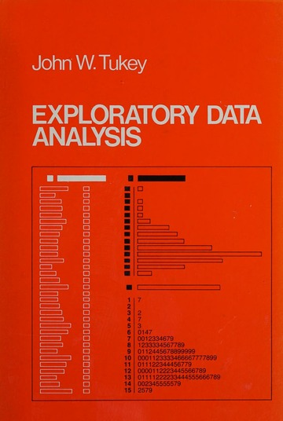

History of EDA
01
Work of Tukey:1977
02
ABC’S of EDA, Velleman and Hoaglin(1981)
03
More graphical analysis has been developed lately
Notes:
5

Slide 4





How EDA Helps in Jobs
Spot Insights
Build Better Models
Extract valuable patterns from raw data.
Create more accurate predictive models.
Improve Reporting
Support Decisions
Enhance quality of data presentations.
Provide data-backed business recommendations.
Essential skill for Data Analysts, Business Analysts, and Risk Analysts.
Notes:
5

Slide 5

Where is EDA Applicable
Banking
Healthcare
Risk profiling and fraud detection
Patient history and risk prediction
Insurance
Retail
Claims assessment and risk underwriting
Customer segmentation and demand forecasting
Notes:
4

Slide 6









EDA Step-by-Step Visual
Business Understanding
Data Collection
Data Cleaning
Univariate Analysis
Bivariate Analysis
Outlier Detection
Correlation Study
Insights
Notes:
Business Understanding
Everything starts with understanding the business problem. What are we trying to solve? What are the goals? This step ensures that our analysis aligns with the business objectives and drives relevant insights.
Data Collection
Next, we gather the data. This can come from databases, APIs, spreadsheets, or even web scraping. Ensuring that the right data is collected is critical to the success of the analysis.
Data Cleaning
Once we have our data, it’s time to clean it. This involves handling missing values, removing duplicates, correcting data types, and resolving inconsistencies. Clean data is the backbone of reliable analysis.
Univariate Analysis
Here, we analyze each variable individually. Whether it's numerical or categorical, we look at distributions, central tendencies, and dispersion to understand how each variable behaves on its own.
Bivariate Analysis
Now we examine relationships between two variables. This could involve scatter plots, box plots, or grouped bar charts. It helps us understand how one variable may influence another.
Outlier Detection
Outliers can distort the results of your analysis. In this step, we use techniques like box plots or z-scores to identify and handle these anomalies.
Correlation Study
We then study correlations to see how strongly variables are related. This step is essential for identifying multicollinearity and choosing the right features for modeling.
Insights
Finally, after all this exploration, we summarize our findings. These insights drive decision-making and set the stage for building predictive models or making business recommendations.

Slide 7







Problem Statement
Risk Analytics
Assess credit risk in loan applications.
Customer Types
With and without payment difficulties.
Decision Impact
Rejecting good customers vs. approving risky ones.
Loan Outcomes
Approved, Refused, Cancelled, Unused Offer.
Notes:
This is an example of a case study which comes from a real-world problem faced by loan providers. Many people applying for loans either have no credit history or a poor one. This makes it difficult for banks to assess risk, and in some cases, this is exploited by people who eventually default.
Our task is to apply EDA – Exploratory Data Analysis – to help the company make smarter lending decisions.
There are two key risks: if we reject a good customer, we lose business; if we approve a risky customer, we may lose money. So the goal here is to find balance.
The dataset has information on clients who either paid on time or had payment difficulties, and for each application, there could be four outcomes: approved, cancelled, refused, or unused.
Using EDA, we want to discover which factors – like income, employment type, or housing – can predict if someone will default. These patterns can help the company make better decisions, offer safe loans, or at least price them appropriately.

Slide 8
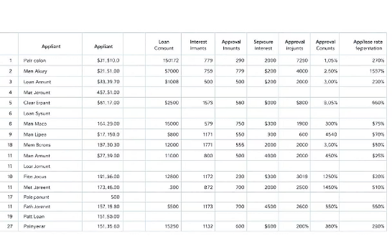
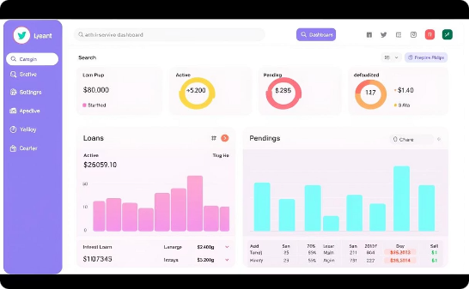
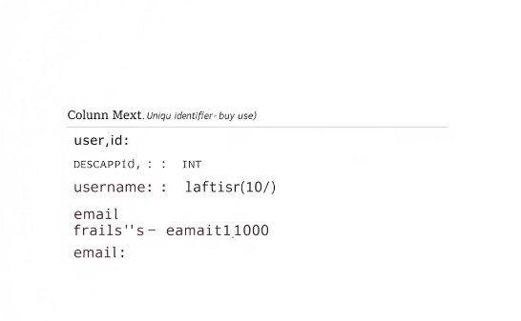
Datasets
Application Data
Previous Applications
Data Dictionary
Current application details with customer information and loan specifics.
Detailed explanation of all variables in the datasets.
Customer's past loan application history and outcomes.
https://www.kaggle.com/datasets/sid9300/credit-eda-case-study-data
Notes:
application_data.csv
- Contains current loan application information (who is applying now)
- Has demographic and financial details
- TARGET column shows whether the customer defaulted or not
previous_application.csv
- Historical record of customer's past loan applications
- Application outcomes: Approved, Refused, Cancelled, Unused
- No TARGET column, but behavior is inferred
Merging both on SK_ID_CURR provides:
- 360° view of the customer (past + present)
- Connect past decisions to current defaults
- Discover if refusals in the past → higher risk now

Slide 9





Approach and Methodology
Data Cleaning
Handled missing data, dropped high-NaN columns (>19%), fixed negatives.
Categorical Fixes
Replaced invalid entries like ‘XNA’ with logical values.
Univariate & Bivariate Analysis
Studied variable distributions and relationships.
Segmentation
Separate analysis for defaulters vs non-defaulters.
Correlation & Outliers
Heatmaps to detect key factors; outliers observed via boxplots.
Notes:
9

Slide 10
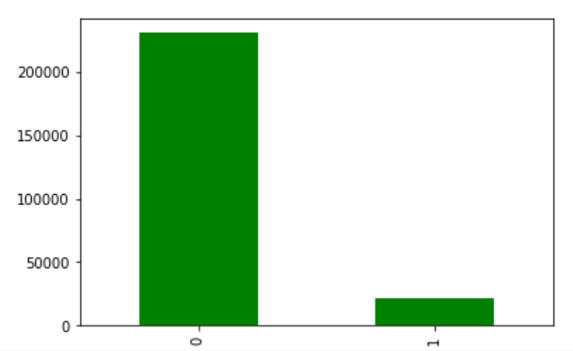
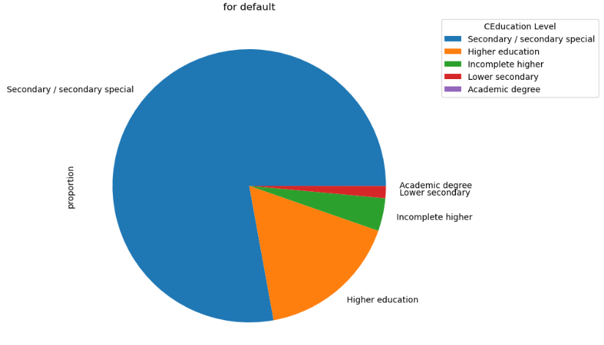
Target Variable Distribution
Education Level Pie Chart
Shows non-defaulters dominate
Shows secondary education is most common among defaulters
1 = defaulters (customers who failed to repay loans).
0 = non defaulter (customers who successfully repaid loans).
Notes:
"Here, we look at the TARGET variable from the application data. It tells us whether a customer has defaulted on a loan or not. As seen in this bar chart, the majority of applicants successfully repaid their loans, while a smaller portion defaulted. This imbalance is crucial. It shows we can’t rely only on accuracy when building models, but need to focus on identifying the defaulters effectively."
"Here, we observe the education background of defaulters. Secondary education dominates this chart. This is key because education often correlates with financial awareness and stability. It may be worth investing in financial literacy programs for this segment or applying stricter checks during evaluation."

Slide 11
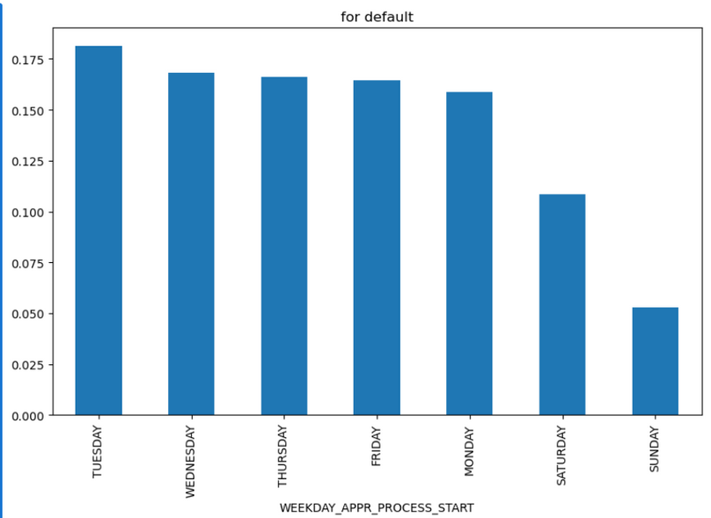
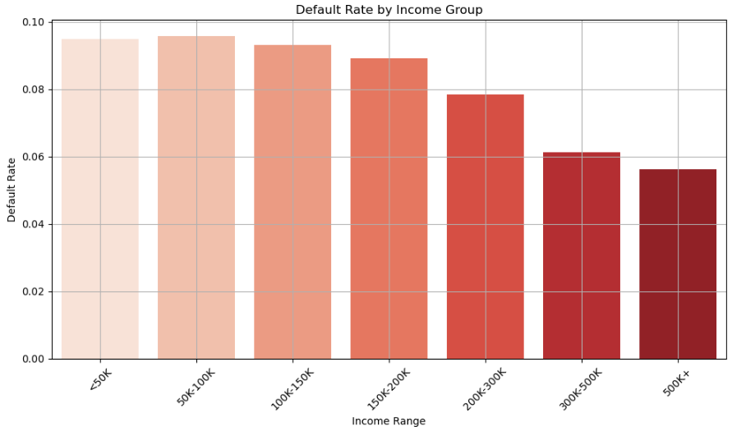
Income vs Default
Application Timing Bar Chart
Shows activity highest on weekdays
Lower income is a significant risk indicator.
Notes:
"This bar chart represents the number of loan applications by weekday. You can see peaks on Tuesdays and Wednesdays. It’s an operational insight— banks can align staffing and processing capacity based on demand, improving efficiency."
"This visualization shows how income levels relate to loan defaults. We’ve grouped customers into income ranges and measured default rates. As expected, lower-income applicants show higher default rates. This insight is important for banks— it suggests tighter eligibility checks or adjusted loan amounts for this group."

Slide 12
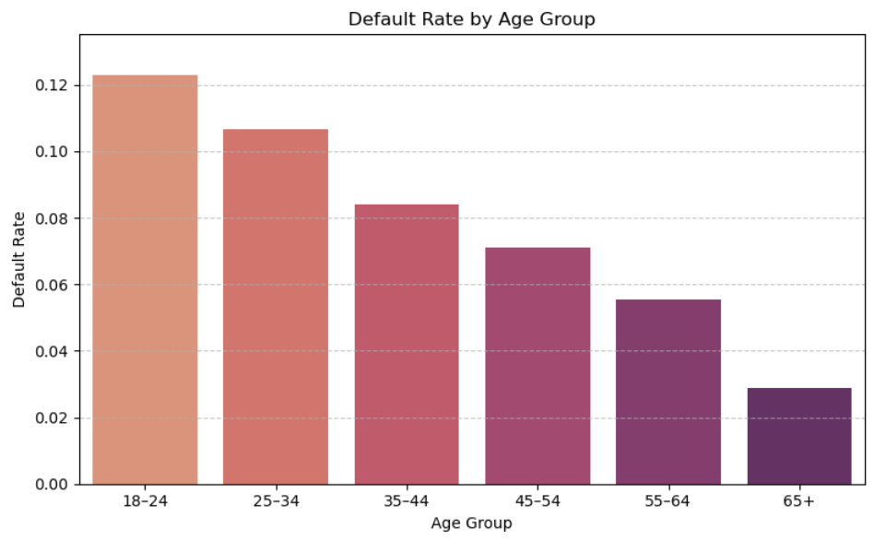
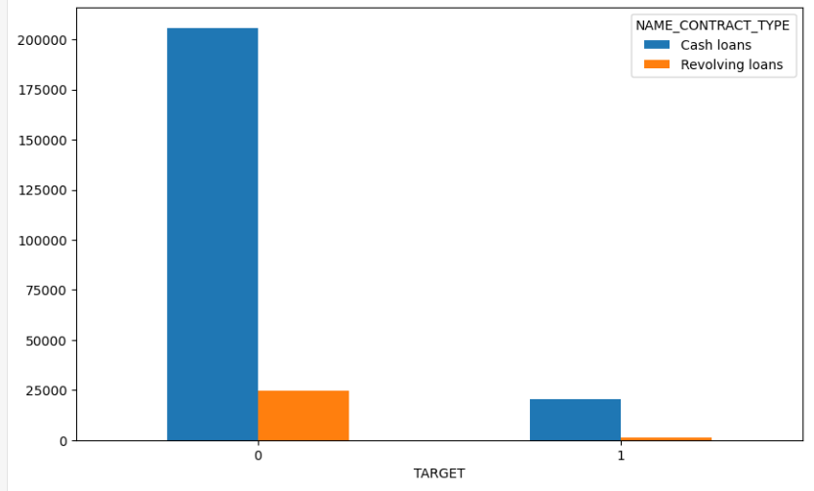
Loan Type vs Target
Age Distribution
Proves younger customers are riskier
Proves cash loans = higher defaults
Notes:
"This analysis converts `DAYS_BIRTH` into actual age groups. Younger applicants, especially those in their 20s and 30s, are more likely to default. This supports the idea that age, and perhaps financial maturity, plays a role in repayment behavior."
"This chart compares loan types with default rates. Cash loans clearly have a higher percentage of defaults compared to revolving loans. This suggests that cash loans are riskier and banks may need different policies or interest rates for them."

Slide 13
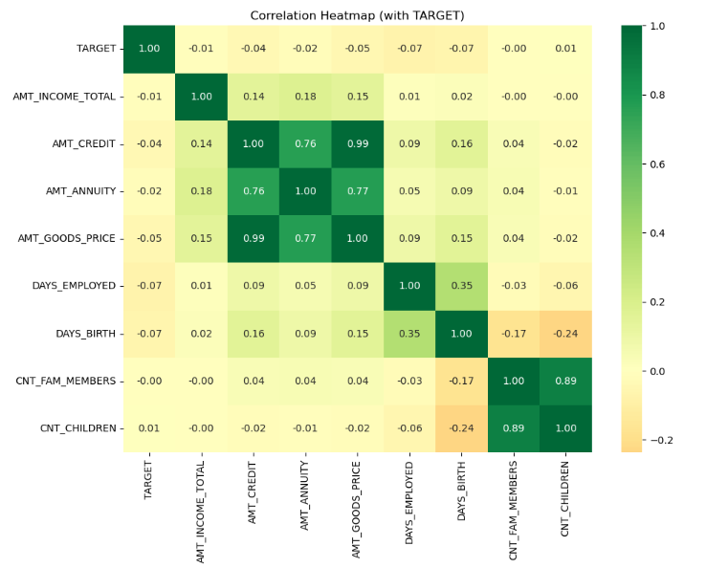
Correlation Heatmap
Shows strong links: income, credit, employment vs default
Notes:
"This heatmap shows correlations between numerical variables and loan default. We see a slight negative correlation with days employed and a weak negative link with income. Interestingly, income isn’t strongly predictive by itself. Features like employment duration and age are more informative."

Slide 14
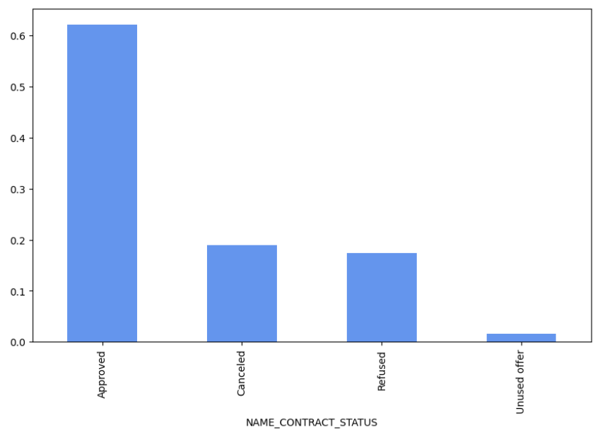
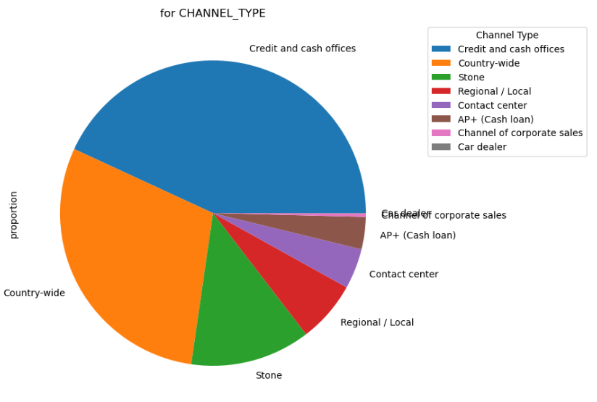
Channel Type
Loan Status Distribution
Shows previous refusals are significant
Supports how loans are processed
From previous_application.csv
Notes:
"This chart is from the previous application data. It shows the distribution of past loan outcomes. Notably, customers with previously refused loans have a higher tendency to default now. This tells us past behavior is a useful indicator of future risk."
"This slide shows how customers applied for past loans—through credit offices, POS terminals, or cash dealers. Credit offices dominate, but cash dealers, though fewer, might handle higher-risk applicants. Understanding this can help banks manage partner risks."

Slide 15
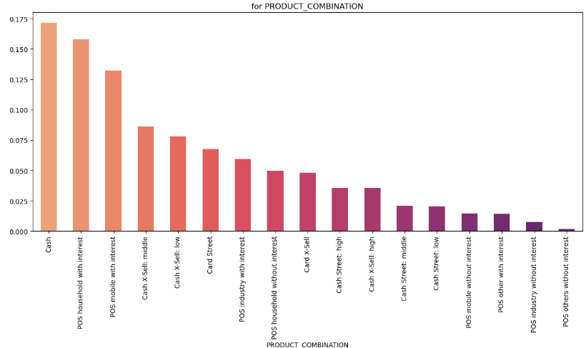
Product Combination
Spot patterns of simple vs bundled loans
From previous_application.csv
Notes:
"We’re looking at what kind of product bundles people applied for. Most applicants go for standalone cash loans. These might be taken out urgently, indicating potential financial strain. Customers using bundled products might be more financially stable."

Slide 16
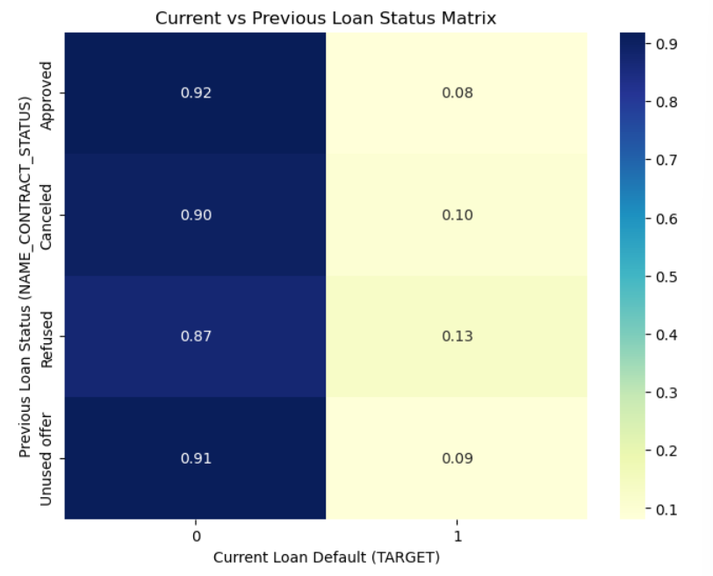
Current vs Previous Loan Status
Links past refusals to current defaults
From Merged Dataset
Notes:
"This matrix compares past loan statuses with current default behavior. We see that applicants with previous refusals have a higher default rate now. This validates the idea that previous history is predictive— and should be part of credit scoring models."

Slide 17
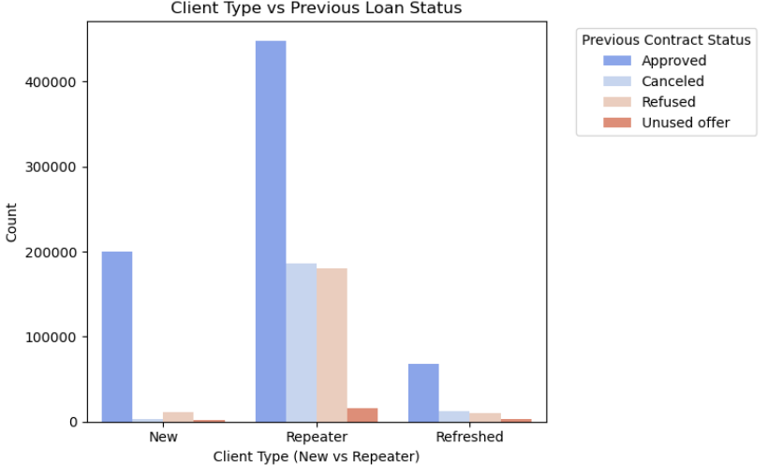
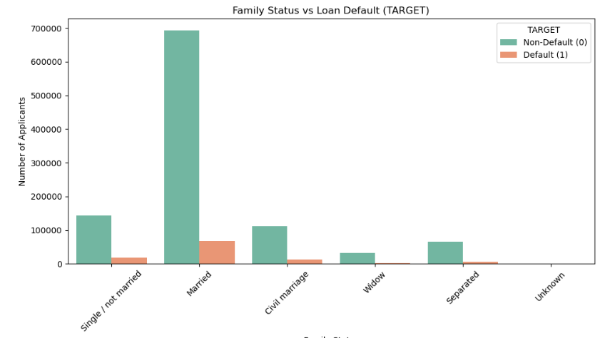
Family Status vs Loan Status
Client Type vs Contract Status
Adds socio-demographic dimension to profile
Repeating clients more likely to be approved, safer
From Merged Dataset
Notes:
"Here, we compare family status with current loan default. Married applicants show lower default rates. This may be because marriage brings dual incomes or more financial stability. This type of demographic insight can help refine customer segmentation."
"Finally, we look at whether being a new or repeat customer affects risk. New applicants are more often refused—suggesting higher risk—while repeat clients tend to be more trusted and get approved more easily. Client type should definitely be a feature in risk models."
"In summary, EDA helped us uncover key insights: most customers are non-defaulters, but defaults concentrate among the younger, lower-income, and less educated. Past refusals, cash loans, and client type offer predictive value. This reinforces how crucial EDA is for risk analysis and smarter loan decisions."

Slide 18

Conclusion
Customer Profile
Risk Factors
Most customers are non-defaulters
Lower-income customers show higher risk
Secondary education common among defaulters
Younger customers have higher default rates
Application activity highest on weekdays
Cash loans riskier than revolving loans
Strong correlations found between employment, income, and default rates.
Notes:
10

Slide 19


